Slide 1
VX 420: Business Basics for Entrepreneurship
The Lean LaunchPad: Customer Relationships
Version 6/15/12

Slide 2
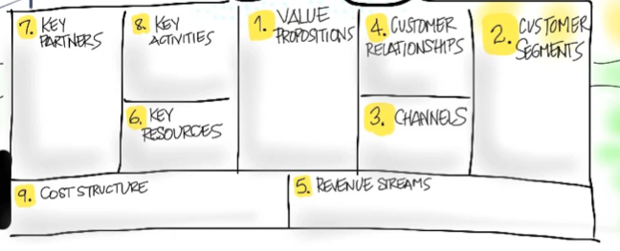
Customer Relationships
How do you Get, Keep and Grow Customers?

Slide 3
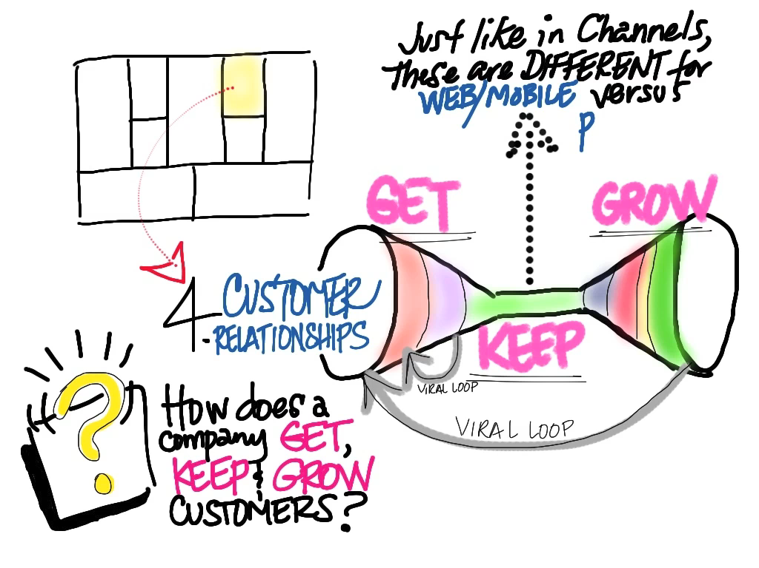
© 2012 Steve Blank

Slide 4
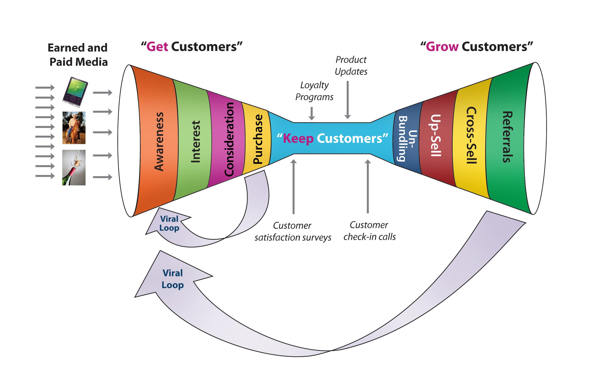
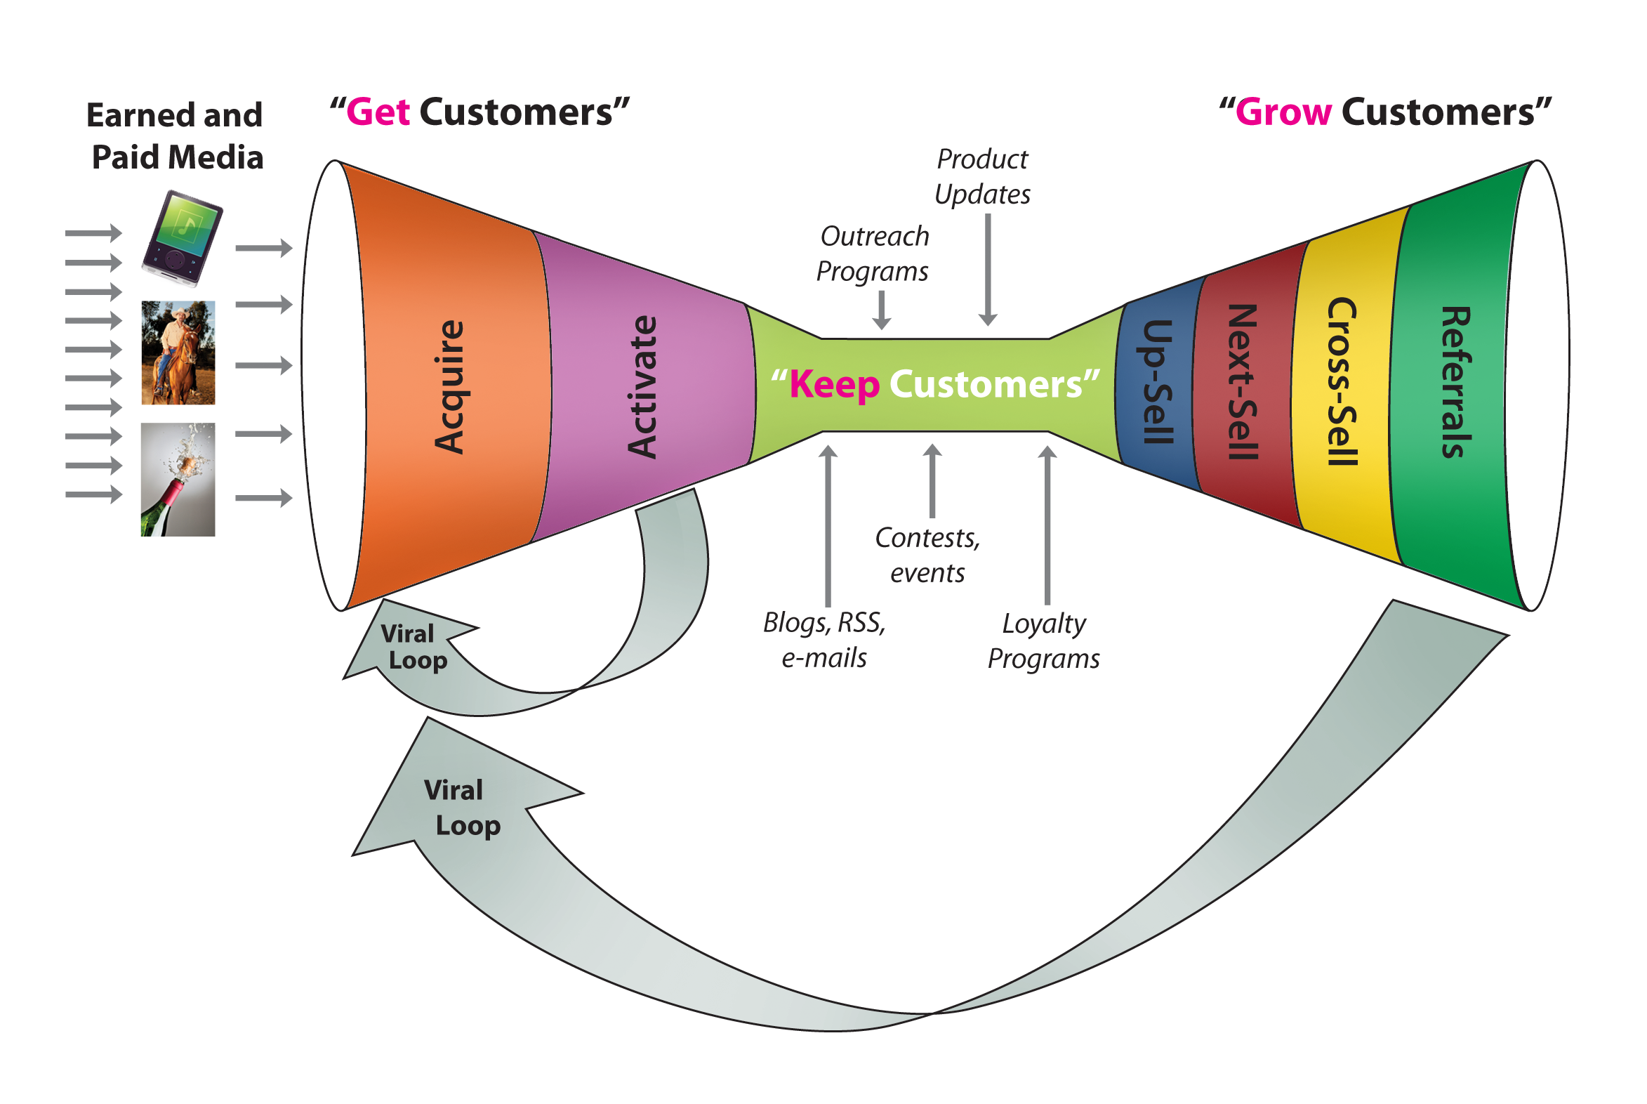
Customer Relationships Physical & Web Mobile Are Different
© 2012 Steve Blank

Slide 5
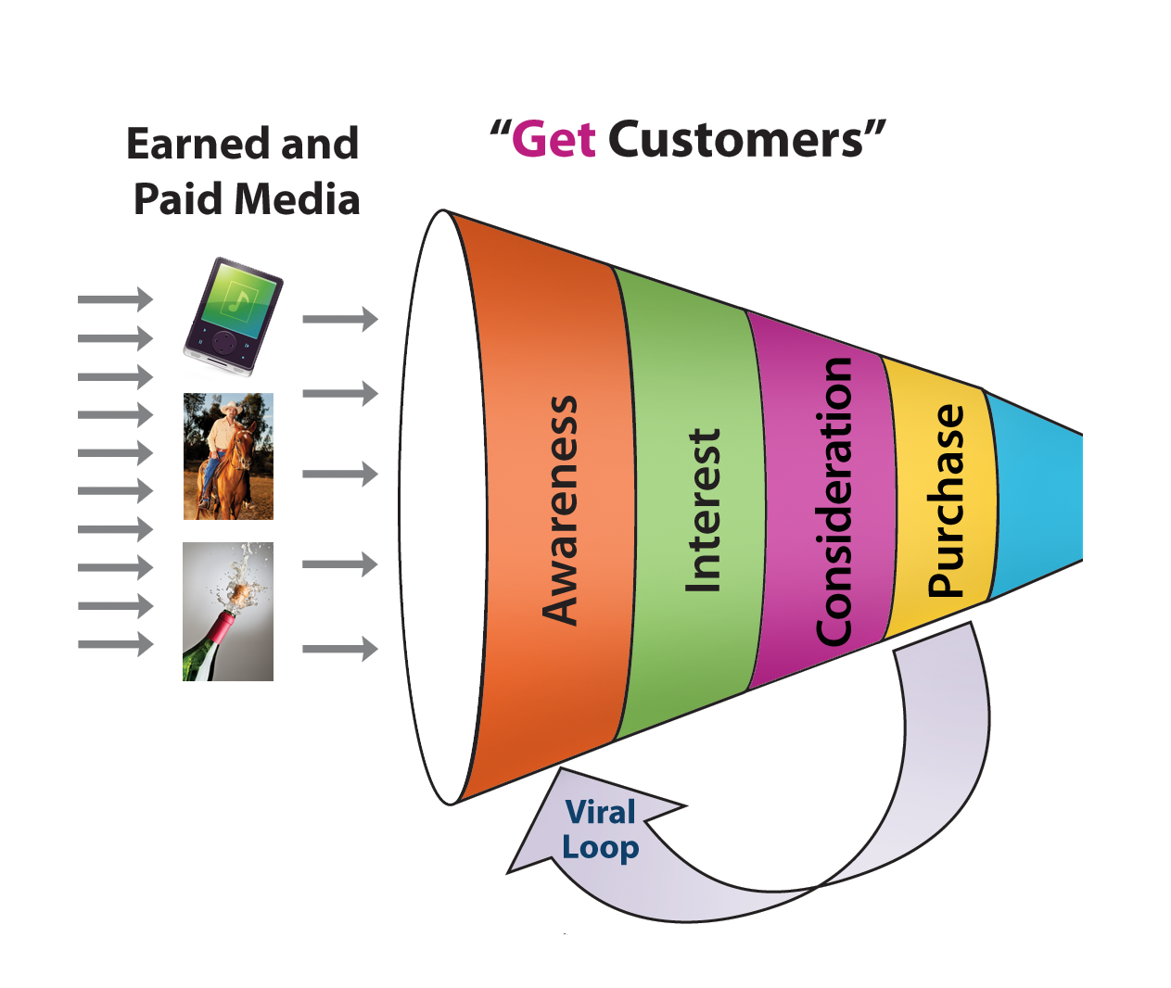
Customer Relationships Physical Products – Get Customers
© 2012 Steve Blank

Slide 6
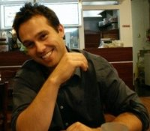
Customer Archetypes Drive Get/Keep/Grow
Lab Manager: Brian
What’s their role?
How this person is evaluated / promoted / compensated?
Who are they?
Buyer’s name
Position / title / age / sex
How do they buy?
Discretionary budget (name of budget and amount)
What matters to them?
What motivates them?
Who influences them?
What do they read/who do they listen to?

Slide 7
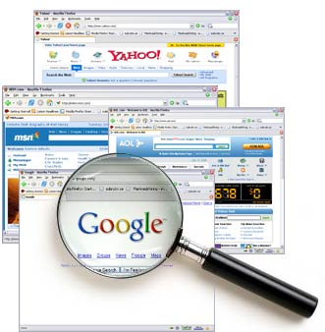

Paid Demand Creation Activities “Paid” Media
Demand
Creation
Public Relations
Advertising
Trade Shows
Webinars
Email marketing
On-line SEM
Biz Dev

Slide 8
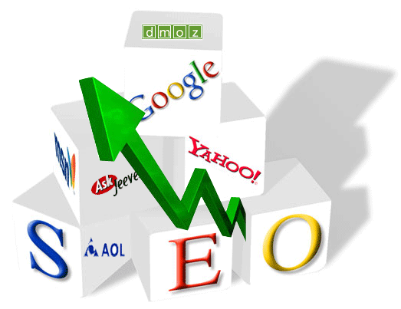

Free Demand Creation Activities “Earned” Media
Demand
Creation
Publications in journals
Conference speeches/papers
Educational seminars
Public relations
Blogging / Sharable content
Social Media
Communities

Slide 9
Customer Relationships Physical Products – Get Customers
© 2012 Steve Blank

Slide 10
Customer Relationships Physical Products – Get Customers
CAC =
Customer Acquisition Cost
© 2012 Steve Blank

Slide 11
Customer Acquisition Cost versus Sales Complexity
Light Touch Inside Sales
High Touch Inside Sales
Field Sales
Field Sales with SE’s
Freemium
No Touch Self-Service
Rough Estimates of Cost of Customer Acquisition (CAC)
$50 – $200
$1,000 - $2,000
$3,000 - $8,000
$25,000 – $75,000
$75,000 – $200,000
$0- $10
Source: David Skok Matrix Partners

Slide 12
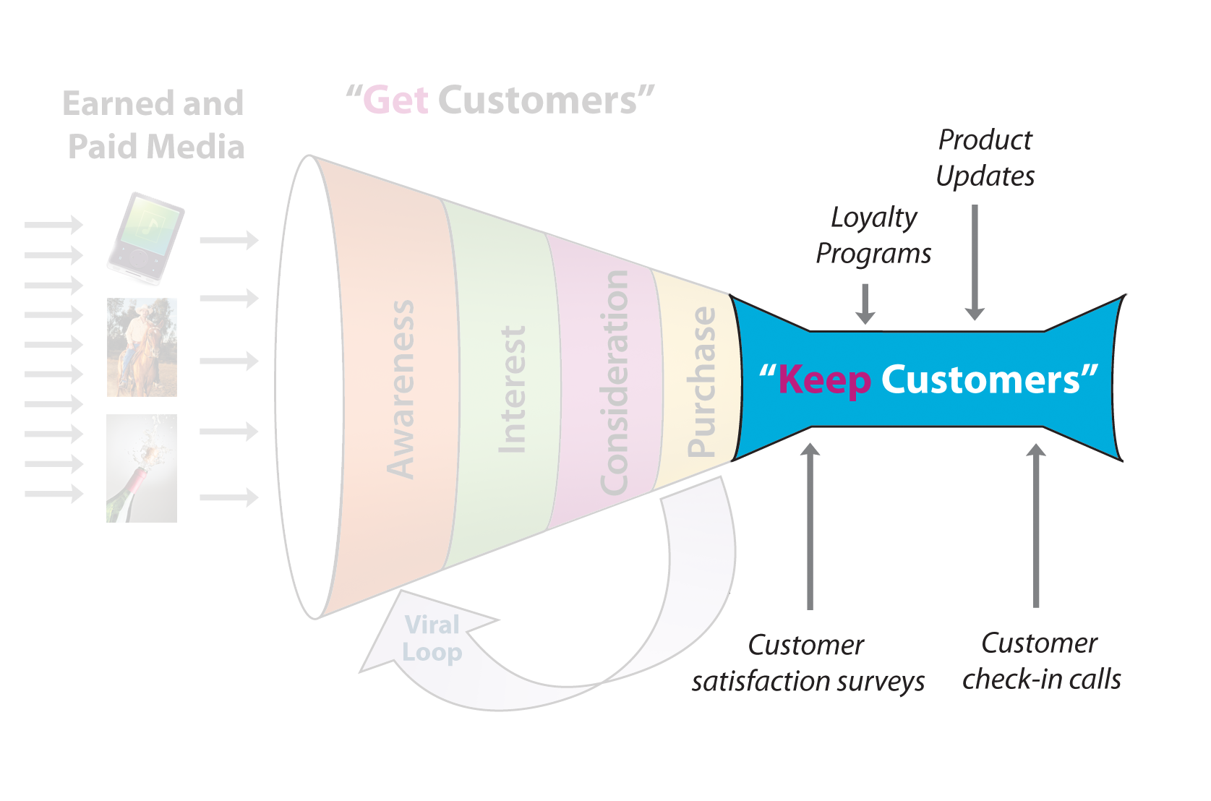
Customer Relationships Physical Products – Keep Customers
© 2012 Steve Blank

Slide 13
Customer Relationships Physical Products – Keep Customers
Attrition/Churn
© 2012 Steve Blank

Slide 14
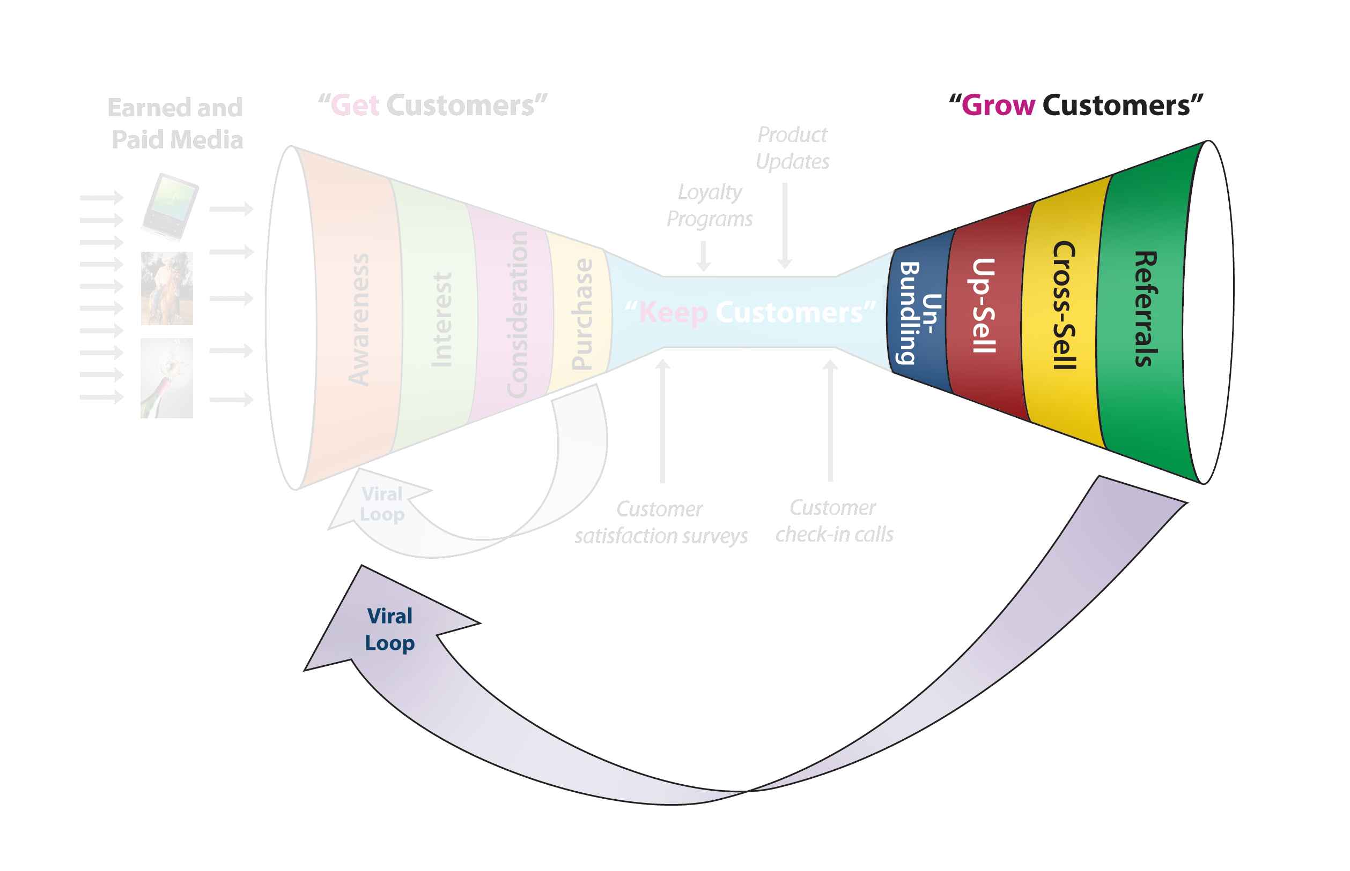
Customer Relationships Physical Products – Grow Customers
© 2012 Steve Blank

Slide 15
Customer Relationships Physical Products – Get/Keep/Grow
LTV = Customer Lifetime Value
© 2012 Steve Blank

Slide 16
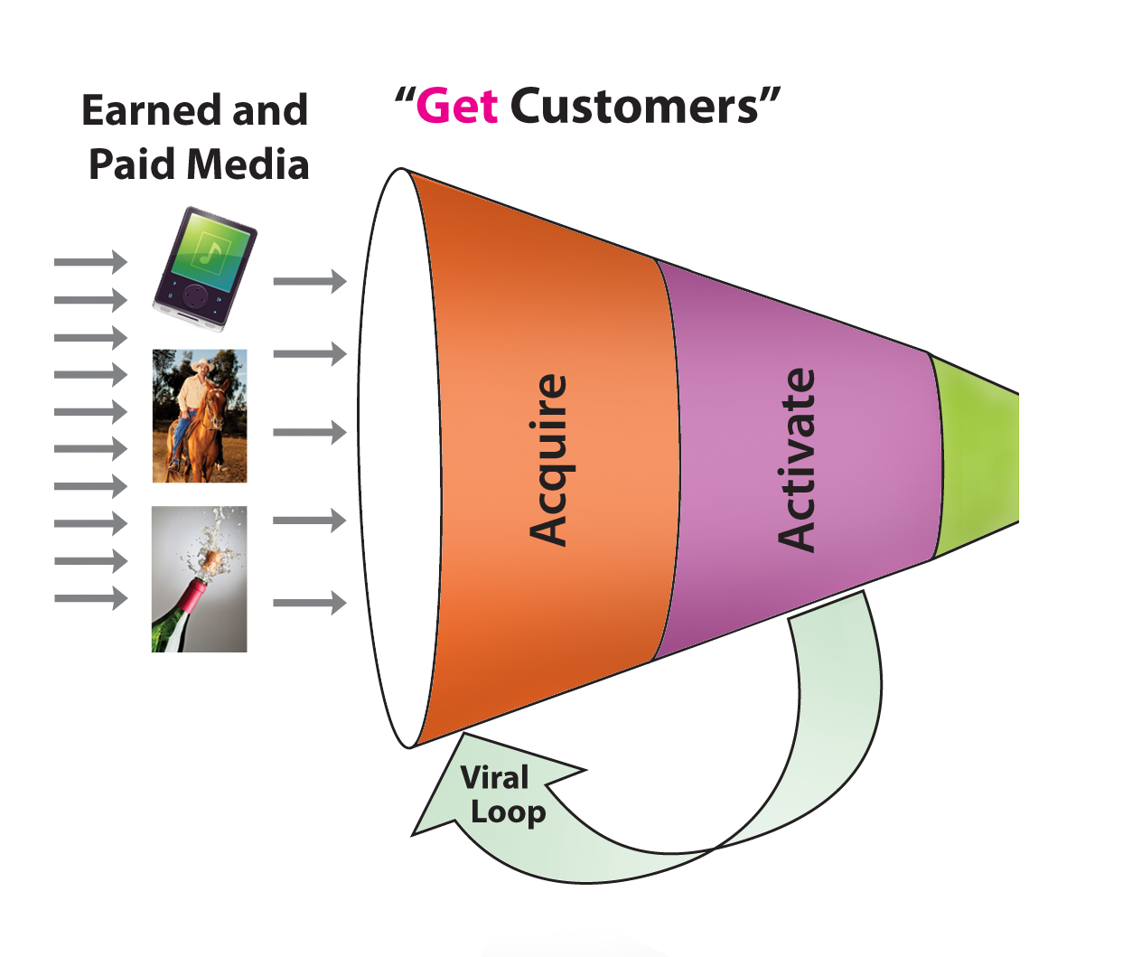
Customer Relationships Web/Mobile Products– Get Customers
© 2012 Steve Blank

Slide 17
Web/Mobile Products– Get Customers
CPM = cost per thousand hits
© 2012 Steve Blank

Slide 18
Web/Mobile Products– Get Customers
CPA = Cost per Action
© 2012 Steve Blank

Slide 19
SaaS Products– Get Customers
Organic Traffic, SEM, Other Paid Sources
Registered Visitors
Raw Leads
Qualified Leads
Inside Sales
Closed Deal
© 2012 Steve Blank

Slide 20
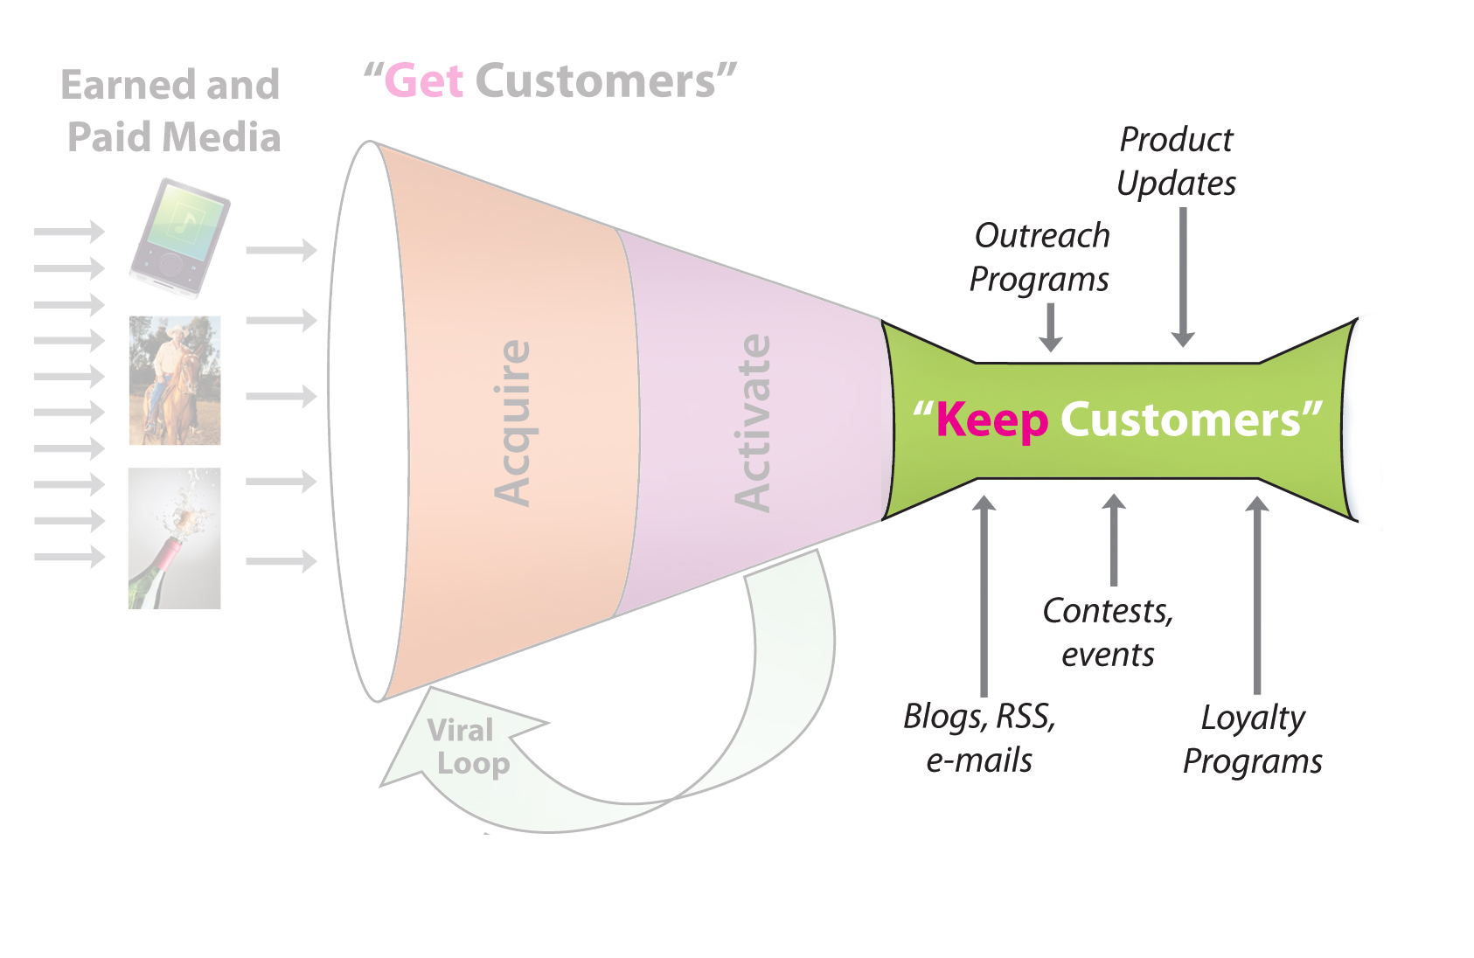
Web/Mobile Products– Keep Customers

Slide 21
Our Example Marketing Funnel
Quick Marketing Calculation
50% | amount of traffic that is organic versus paid
$1.50 | cost per paid visitor (Google AdWords, etc.)
$ 0.75 | Cost per visitor (both paid and unpaid)
3% | visitors convert to raw leads
20% | number of raw leads that turn into qualified leads
1 | qualified lead
5 | raw leads required
167 | visitors required
$125 | Cost of visitors (also = Cost per qualified lead)
Source: David Skok Matrix Partners

Slide 22
Our Example Marketing Funnel
Quick Marketing Calculation
50% | amount of traffic that is organic versus paid
$1.50 | cost per paid visitor (Google AdWords, etc.)
$ 0.75 | Cost per visitor (both paid and unpaid)
3% | visitors convert to raw leads
20% | number of raw leads that turn into qualified leads
1 | qualified lead
5 | raw leads required
167 | Visitors required
$125 | Cost per qualified lead
Source: David Skok Matrix Partners

Slide 23
What Investors are Looking For
A well balanced business model
Monetization (LTV)
Cost to Acquire a Customer (CAC)
Source: David Skok Matrix Partners

Slide 24
The Balancing Act
Viral effects
Inbound Marketing
Free or Freemium
Open Source
Free Trials
Touchless conversion
Inside Sales
Channels
Strategic partnerships
Cost to Acquire a Customer (CAC)
Monetization (LifeTime Value LTV)
Scalable Pricing
Cross Sell/Upsell
Product line expansion
Lead Gen for 3rd parties
Source: David Skok Matrix Partners

Slide 25
The Balancing Act
Viral effects
Inbound Marketing
Free or Freemium
Open Source
Free Trials
Touchless conversion
Inside Sales
Channels
Strategic partnerships
High Churn Rates
Low customer satisfaction
Cost to Acquire a Customer (CAC)
Monetization (LifeTime Value LTV)
Field Sales
Outbound Marketing
Scalable Pricing
Cross Sell/Upsell
Product line expansion
Lead Gen for 3rd parties
Source: David Skok Matrix Partners

Slide 26
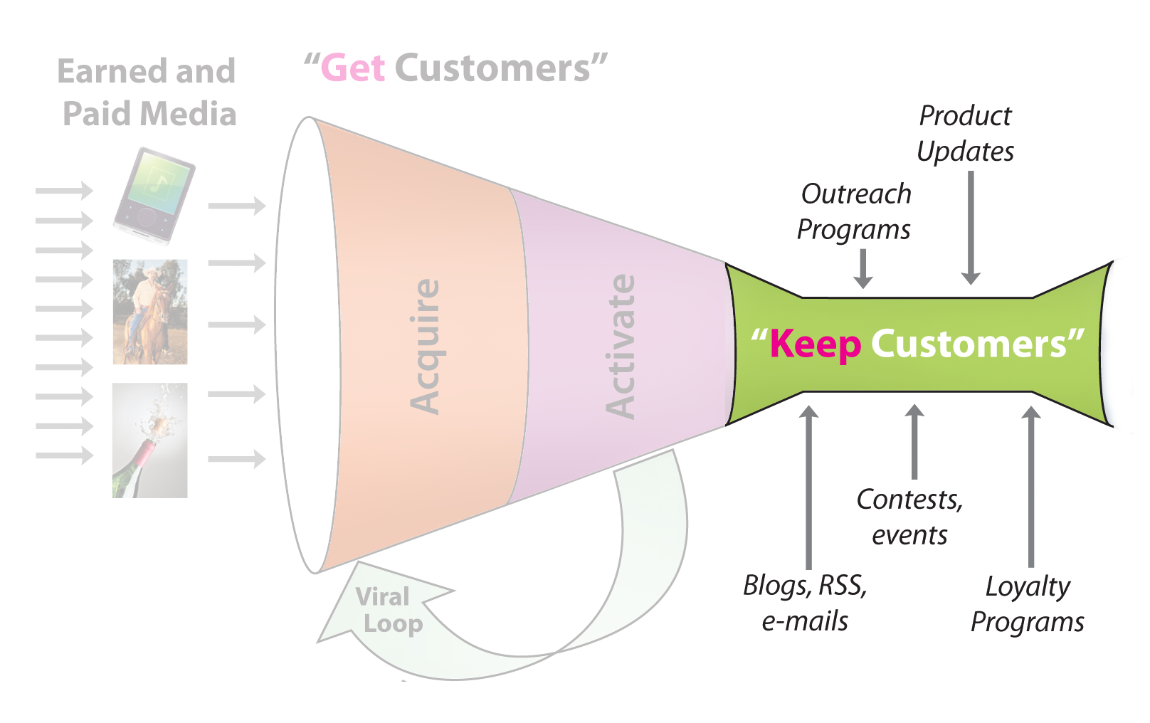
Customer Relationships Web/Mobile Products– Keep Customers
© 2012 Steve Blank

Slide 27
How Churn affects LTV
Average customer lifetime in months =
1 / Monthly Churn
Source: David Skok Matrix Partners

Slide 28
How Churn affects Lifetime
Months
Monthly Churn
Source: David Skok Matrix Partners

Slide 29
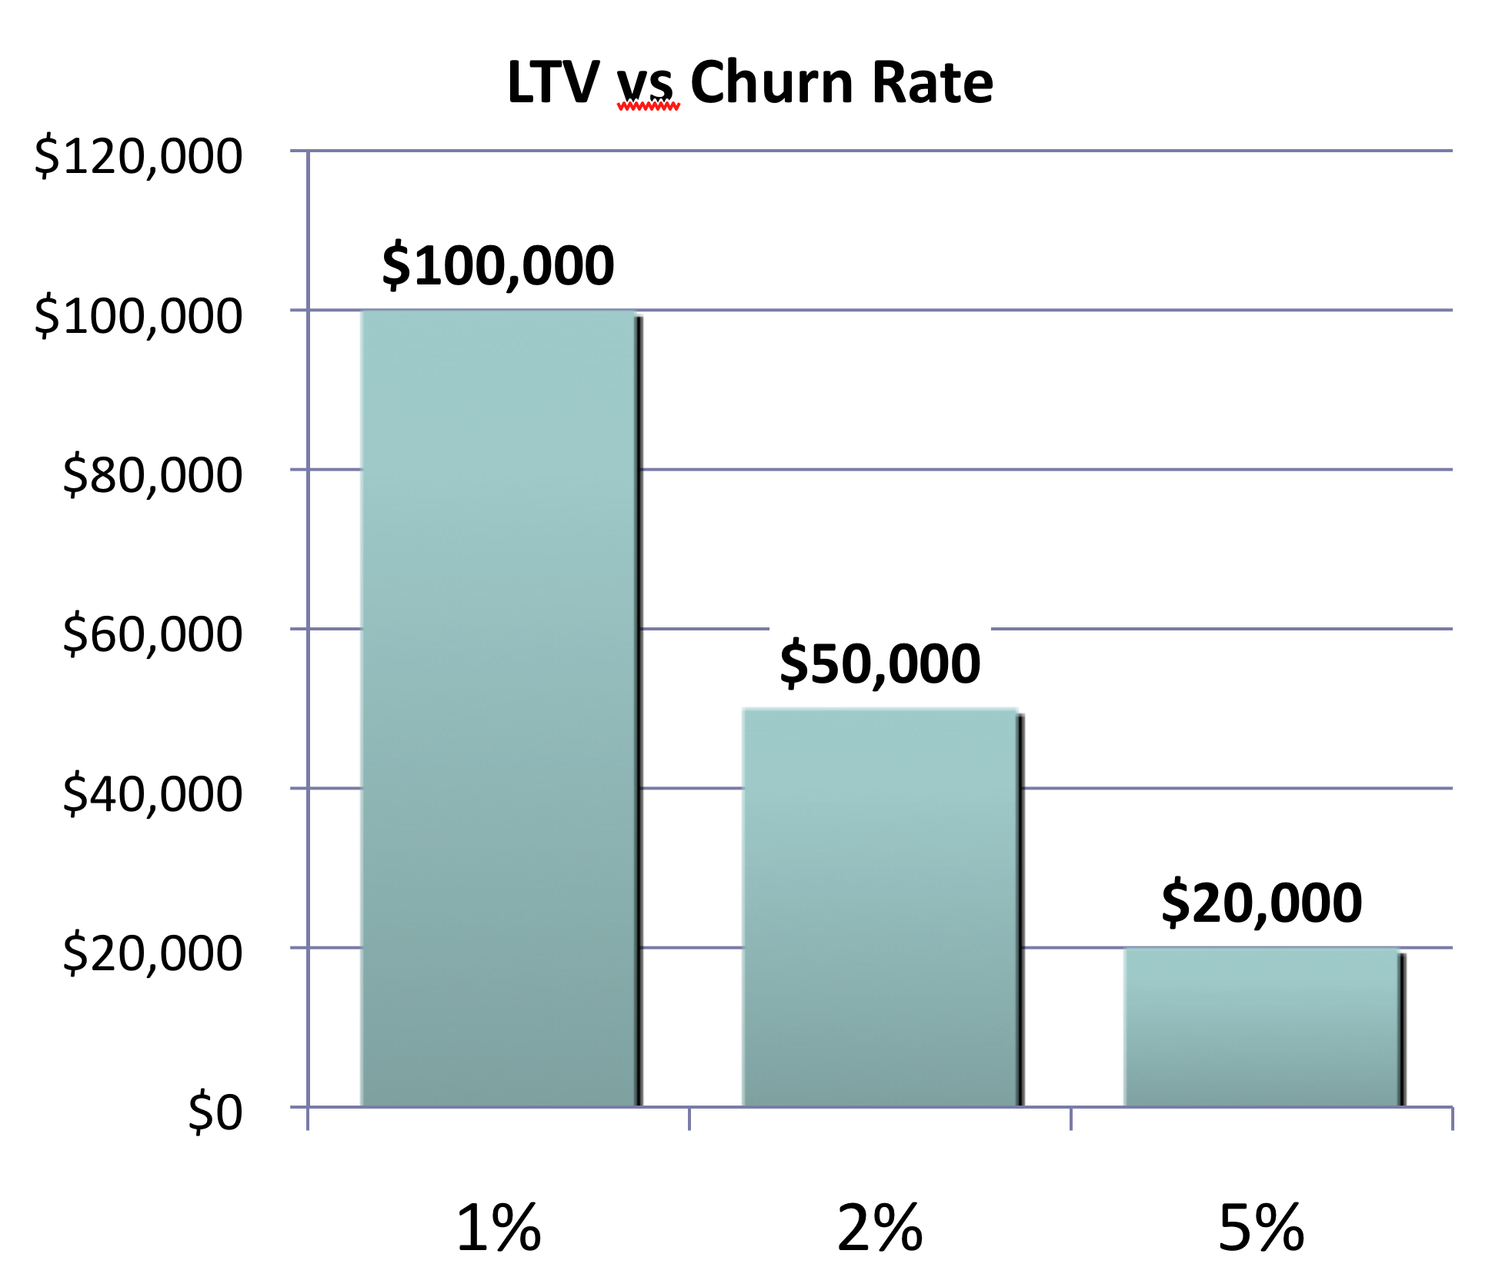
How Churn affects LTV
Lifetime Value
Monthly Churn
Source: David Skok Matrix Partners

Slide 30
Impact of lowering Churn
Impact of lowering the churn rate is felt more heavily in the later years, as expected
It has a significant impact on the long term profitability of the business
Source: David Skok Matrix Partners

Slide 31
Churn
1% to 2.5% churn per month is acceptable
Higher than that, you are filling a leaky bucket
Need to understand why you have low customer satisfaction and address the problem
Source: David Skok Matrix Partners

Slide 32
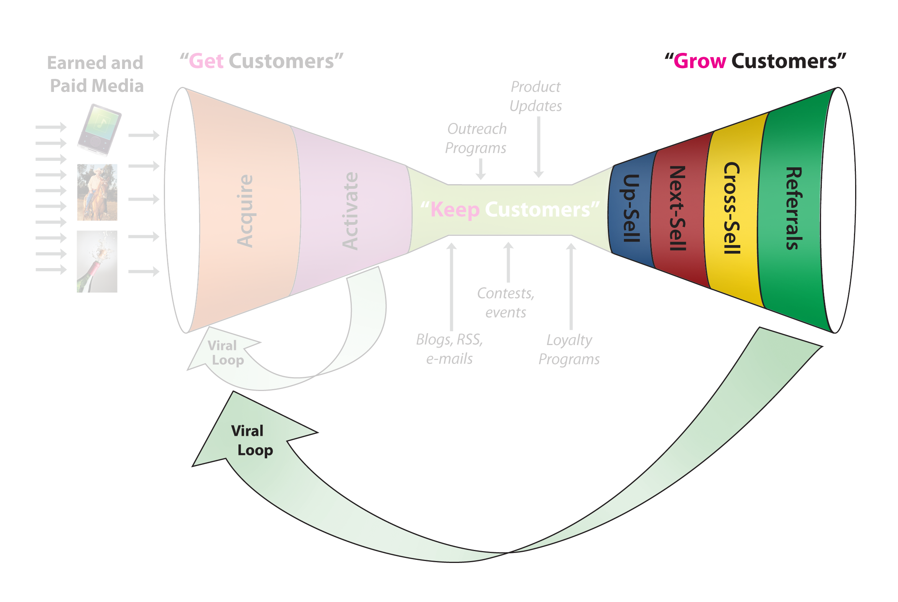
Customer Relationships Web/Mobile Products– Grow Customers
© 2012 Steve Blank

Slide 33
Customer Relationships Web/Mobile Products Get/Keep/Grow
© 2012 Steve Blank

Slide 34
Medical Device Customer Relationships Example

Slide 35
MammOptics
Marketing
Market Adoption
Continuing Medical Education
Conferences
Medical Journals
Key Opinion Leaders (KOLs)
Breast Cancer Advocacy Groups
American College of Obstetricians and Gynecologists (ACOG)

Slide 36
MammOptics
Marketing
Strong influence on doctors via ACOG Standard of Care
Continuing Medical Education
Conferences
Medical Journals
Key Opinion Leaders (KOLs)
American College of Obstetricians and Gynecologists (ACOG)
American College of Obstetricians and Gynecologists (ACOG)
Market Adoption
Strongly influenced by KOLs
Access to ACOG by former member

Slide 37
MammOptics
Marketing
Researchers conducting important clinical trials
Researchers with strong peer recommendations
Market Adoption
Continuing Medical Education
Conferences
Medical Journals
Key Opinion Leaders (KOLs)
American College of Obstetricians and Gynecologists (ACOG)
American College of Obstetricians and Gynecologists (ACOG)
Researchers with numerous publications
Outsourced survey research

Slide 38
MammOptics
Marketing
Market Adoption
Continuing Medical Education
Conferences
Medical Journals
Key Opinion Leaders (KOLs)
American College of Obstetricians and Gynecologists (ACOG)
American College of Obstetricians and Gynecologists (ACOG)
Focus on prominent journals
Need two big publications
Choose KOL as Principal Investigators (PI)

Slide 39
MammOptics
Marketing
Market Adoption
Continuing Medical Education
Conferences
Medical Journals
Key Opinion Leaders (KOLs)
American College of Obstetricians and Gynecologists (ACOG)
American College of Obstetricians and Gynecologists (ACOG)
Effective method for educating doctors
Workshop must be approved by ACOG
Doctors required to attend workshops
Taught by objective medical experts

Slide 40
MammOptics
Marketing
Market Adoption
Continuing Medical Education
Conferences
Medical Journals
Key Opinion Leaders (KOLs)
American College of Obstetricians and Gynecologists (ACOG)
American College of Obstetricians and Gynecologists (ACOG)
ACOG Annual Clinical Meeting
Opportunity for feedback from doctors
Miami Breast Cancer Conference

Slide 41
MammOptics
Marketing
Market Adoption
Continuing Medical Education
Conferences
Medical Journals
Key Opinion Leaders (KOLs)
Breast Cancer Advocacy Groups
American College of Obstetricians and Gynecologists (ACOG)
Trusted information source for patients
Access to media outlets
Critical opinion leader for technology adoption

Slide 42
MammOptics
Customer Acquisition Cost
$120,000
$60,000/e
$30,000
$20,000
Head sales
5 reps
Bonuses
Expenses
Direct sales
CAC
$4,500
$100,000
$60,000
$25,000/e
Marketeer
Coordinator
2 conferences
Marketing
$200
$500
$1,500
$2,000
Processing unit
RF Circuitry
Lasers
Packaging
Device
COGS
$4,200
Assume 200 sales per year at a $25,000 giving a profit of $3.2M

Slide 43
Housing App Customer Relationship Example

Slide 44
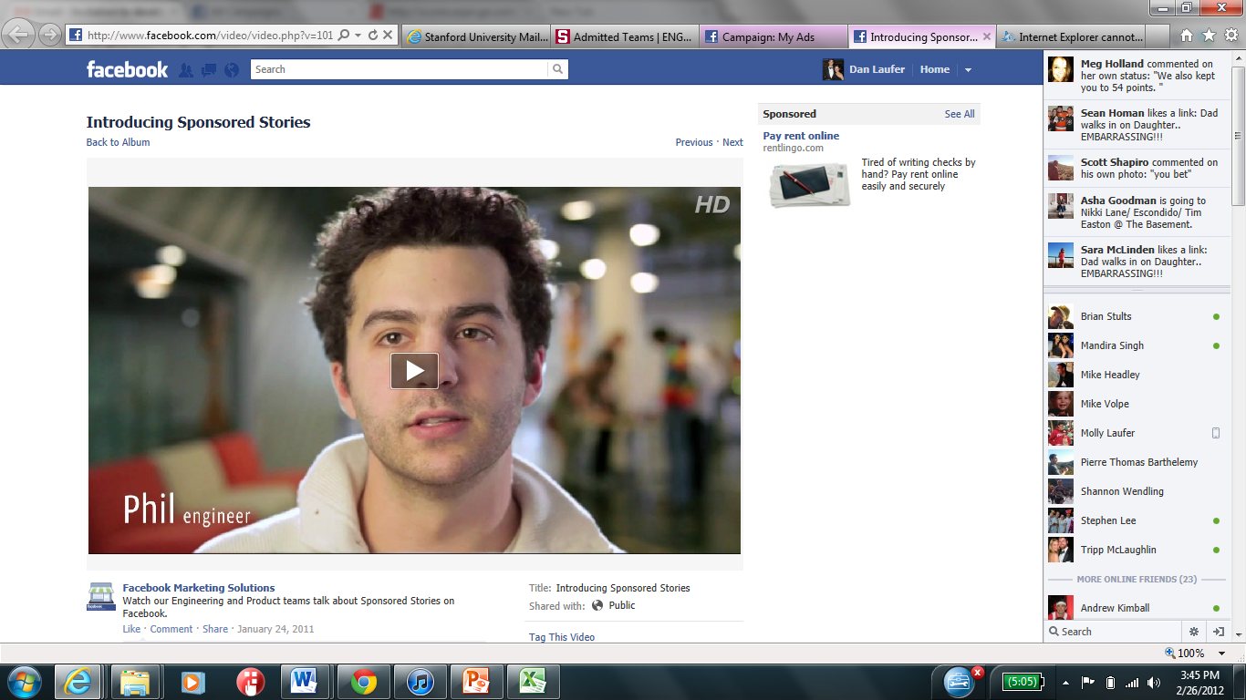
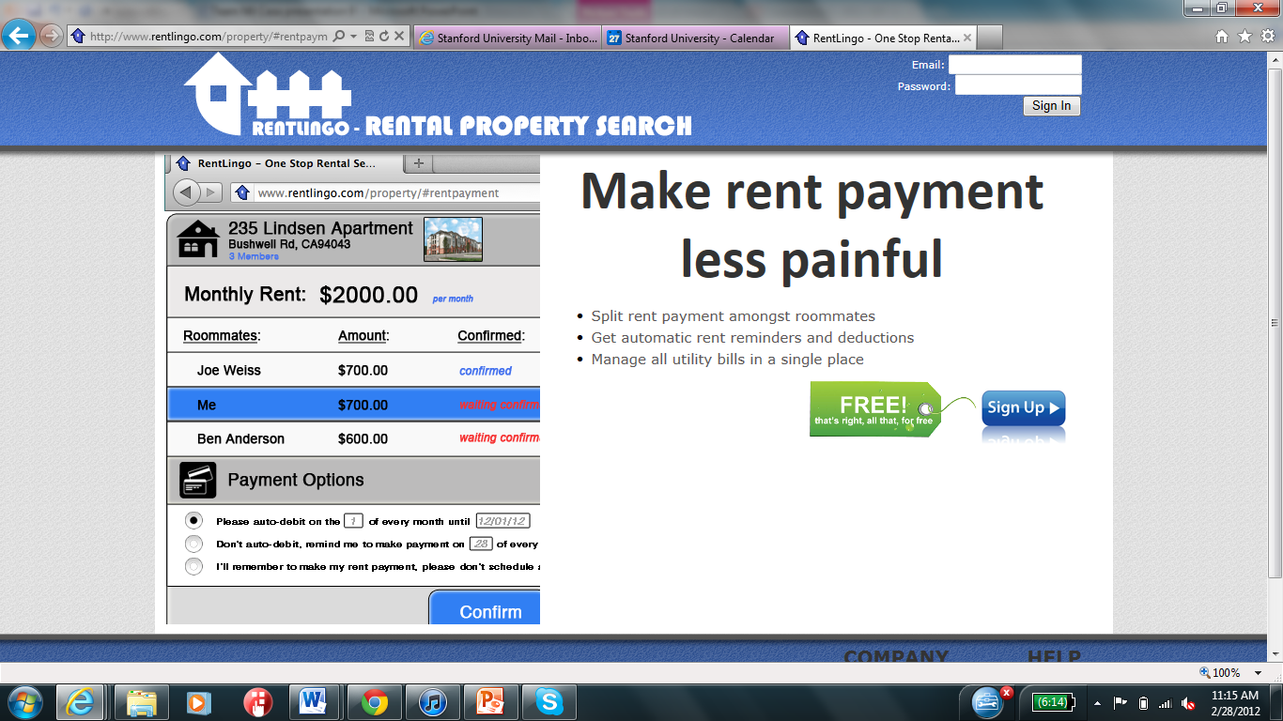
We ran a Facebook ad to test actual willingness to pay for this service
2

Slide 45
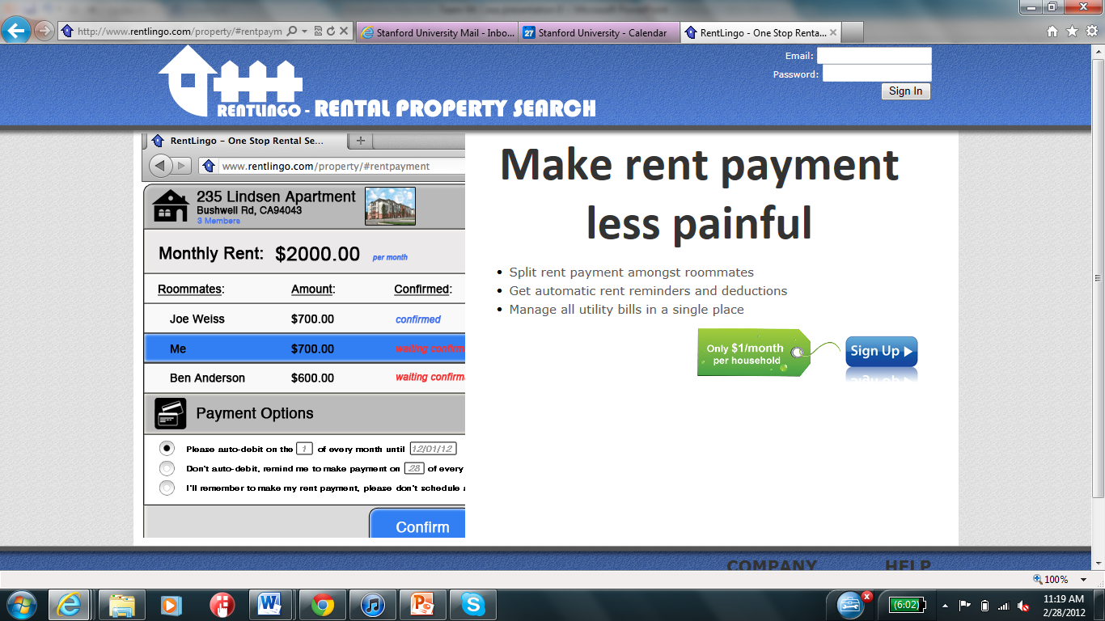

To test willingness to pay we used three identical ads with three different landing pages
2

Slide 46
To test willingness to pay we used three identical ads with three different landing pages
2
Ad | Sign-ups | Clicks | Ad spend
Free | 0 | 23 | $25
$1/household | 0 | 25 | $25
$1/user | 0 | 24 | $25
Unfortunately, test results only proved users did not trust our site for payments
Facebook traffic on this campaign was on our page for 4 seconds on average
Roommate campaign had a 1:37 site time average
Outstanding question: can we win trust in other ways and then engage users to pay rent through us?

Slide 47
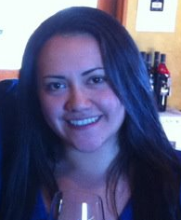
Customer archetype: Sara
How she searches
Wants to be efficient (will use a broker if doing a search on her own is too painful)
Asks friends for recommendations
What Matters to Sara
Wants to live in a fun place that is safe
Doesn’t want to overpay
Doesn’t have much time to hunt for a place
Live with someone she trusts (moving to DC)
Influences
Where friends go out/live
Work location

Slide 48
Mobile App Customer Relationships Example

Slide 49
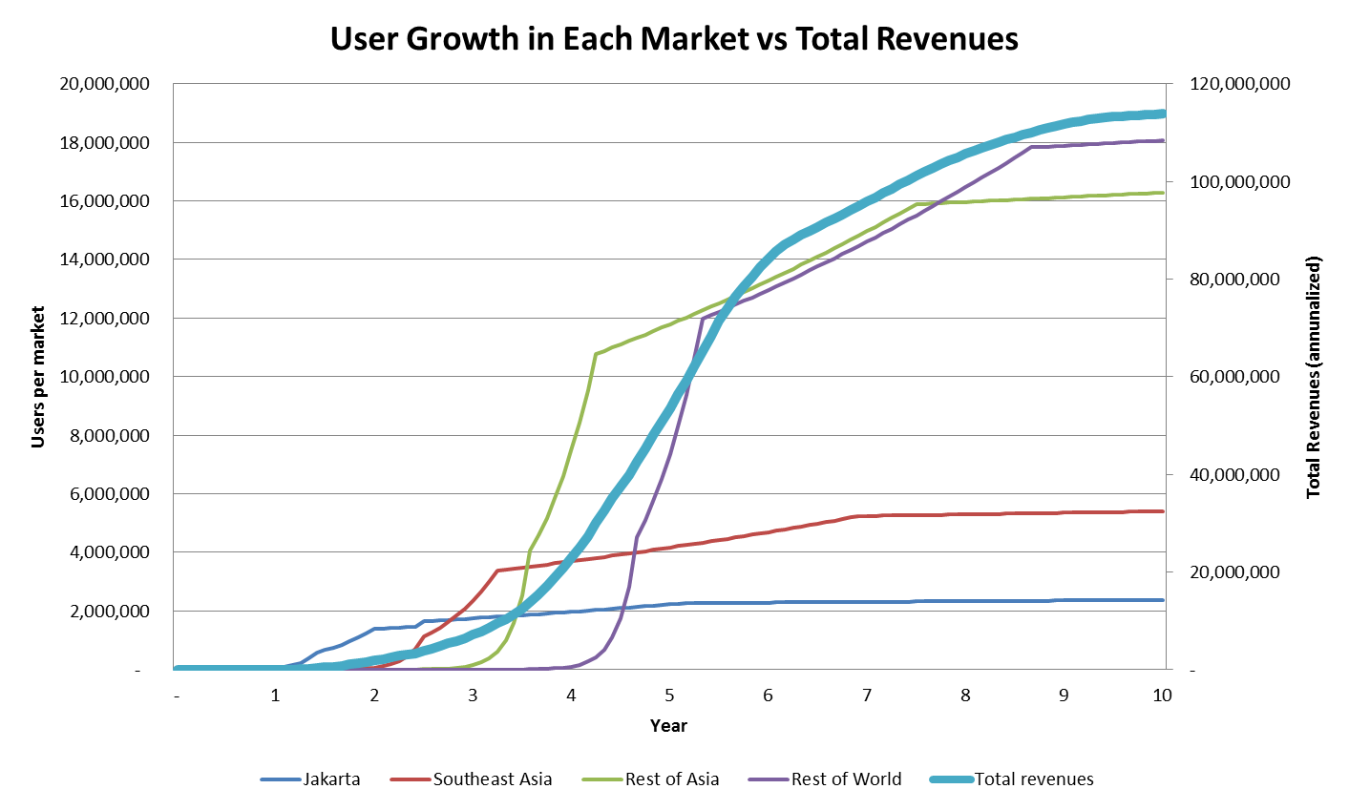
Success Depends on Virality > Churn
Ratio of early stage virality rate to churn rate = 2.00x

Slide 50
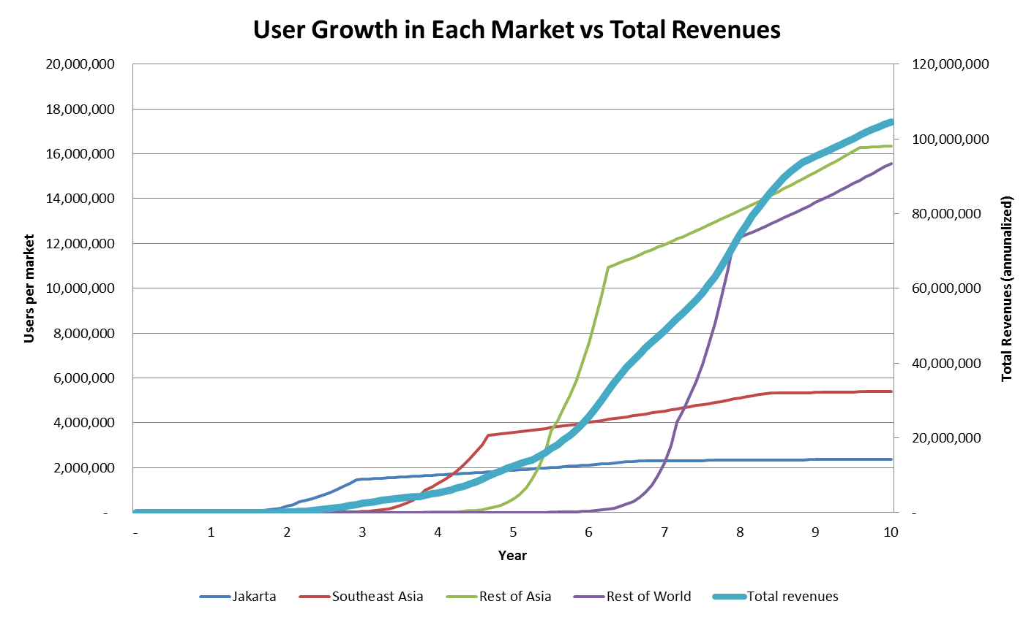
Success Depends on Virality > Churn
Ratio of early stage virality rate to churn rate = 1.50x

Slide 51
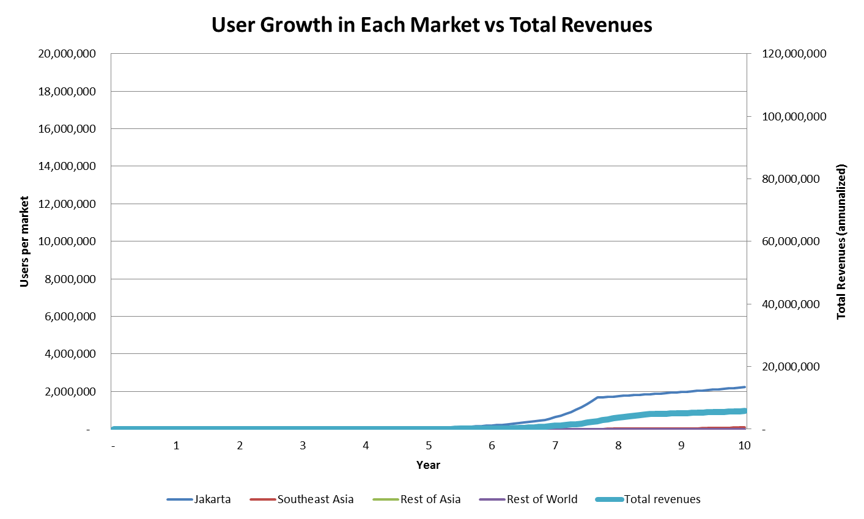
Success Depends on Virality > Churn
Ratio of early stage virality rate to churn rate = 1.0x

Slide 52
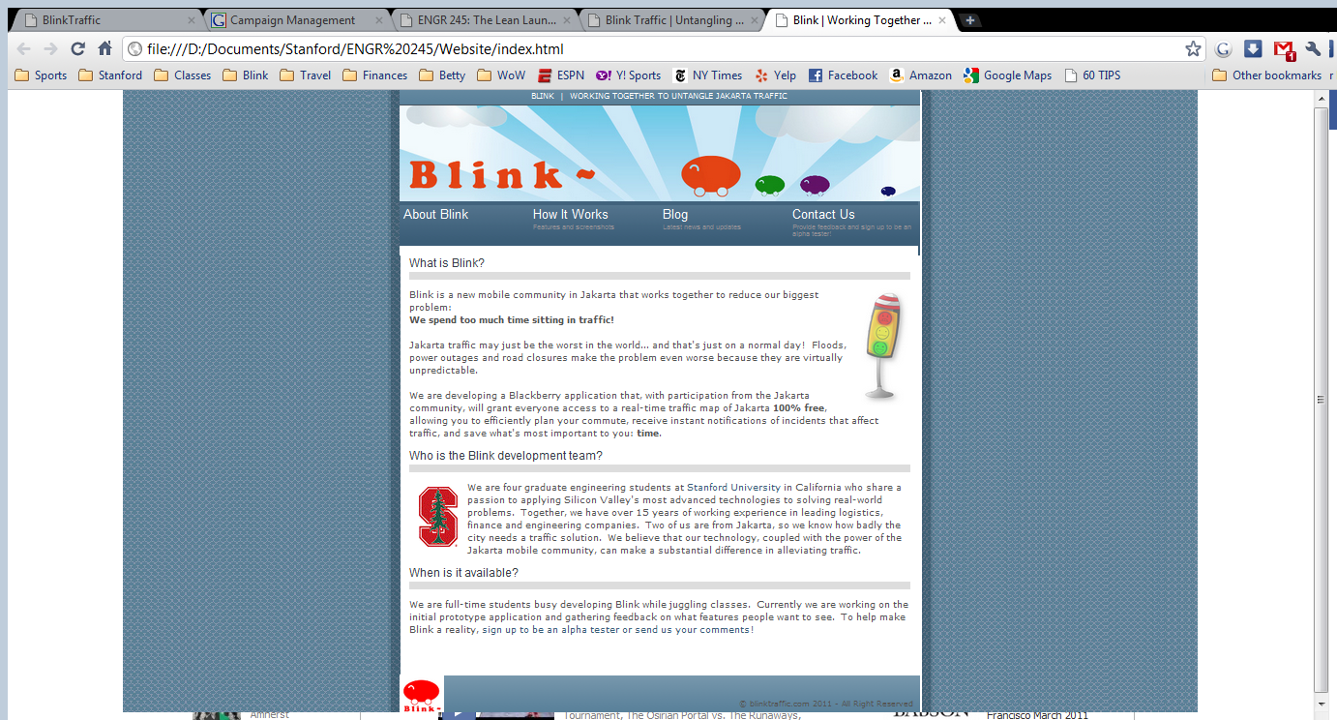
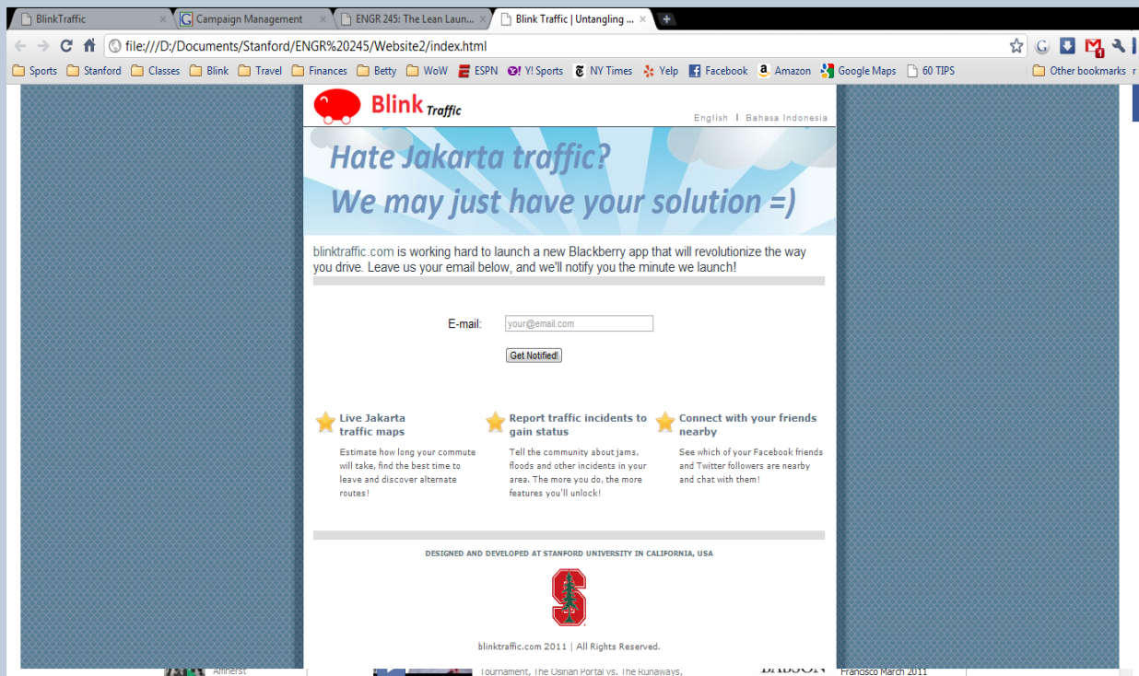
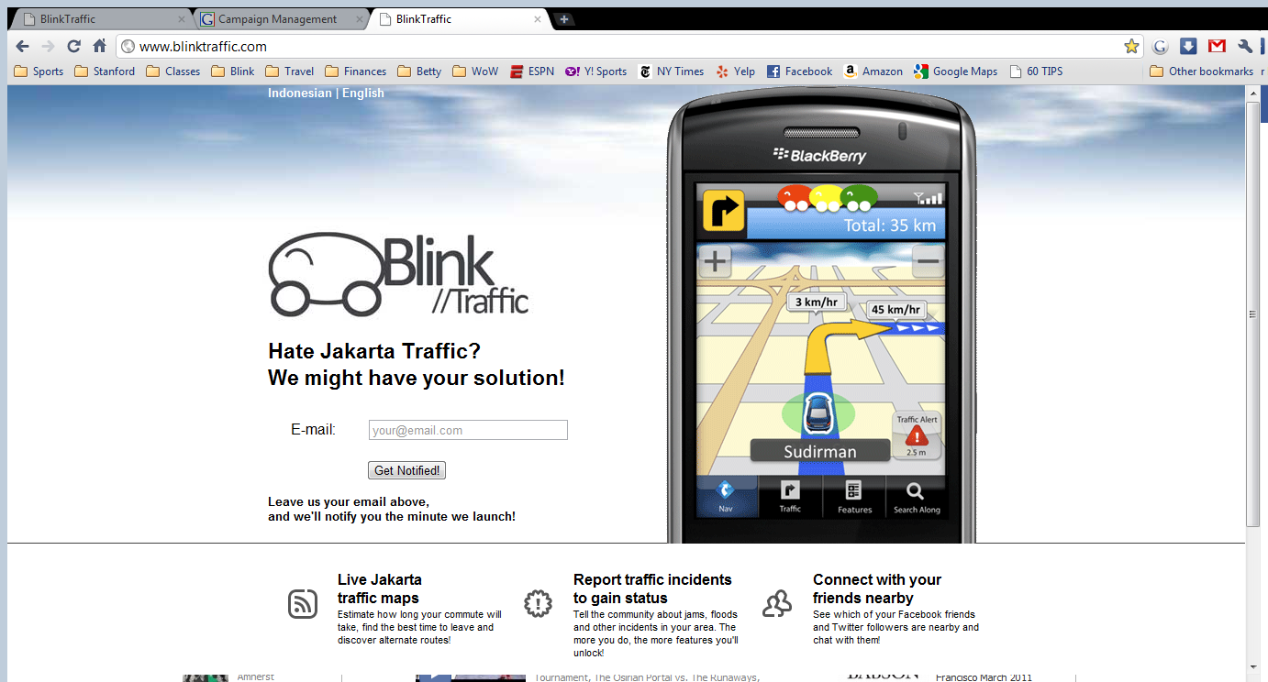
Demand creation via website
1
2
3
“Not a landing page”
No Indonesian version
Doesn’t show the product

Slide 53
Demand creation via website - results
People need to use the product
for us to maximize learning

